Slide 1

Wine not? Pouring into Wine Review Trends in Price, Location, and Variety
Michael Weikman, Nicole Norman, Usman, Haoon Kim

Slide 2
Our Hypothesis
Analyze a data set of wine reviews based on location, winery and price
Determine how price affects a wine’s rating
Analyze how different regions review ratings for wine with different data points verus price point
Find the correlation between different varieties of wine and its popularity by country
We performed EDA (Exploratory Data Analysis) on a wine data set to determine the outcome
Data source is from Kaggle, source code: “https://www.kaggle.com/zynicide/wine-reviews”

Slide 3
Data Cleanup and Exploration
We used kaggle’s api to pull down the data from their website. The data came in a zip format and required unzipping in order to get a workable csv. There were some columns that were unnecessary for our needs and so we ended up dropping them. This was done for pure aesthetic reasons and keeping them would not have impacted our results.
During plotting we cleaned the the rows of empty value cells. From my understanding pandas skips cells with no values during interpretation of the data but regardless to be safe we removed them all the same.
After plotting many of the graphs it was clear that the outlier points would need to be filtered due to their distance from the other points ($100 - $2000). The impact on the graphs scale made measure the data difficult and so it was decided to take in inclusive range of the data points between both the upper and lower outliers of price and use that for plotting.

Slide 4
Does Price Impact Rating: Data Details
Count of price data points: 120,975
Count of price data points $100 and under: 117,609 (97.2%)
Count of price data points over $100: 3,366 (2.78%)
Mean price of wine: $35.36
Minimum price of wine: $4
Maximum price of wine: $3,300
Mean rating: 88.45%
Minimum rating: 80%
Maximum rating: 100%

Slide 5
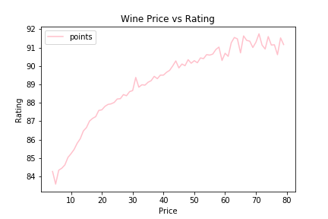
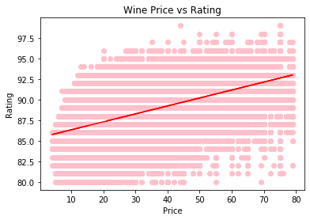
Does Price Impact Rating: Between Outliers
In order to perform the most accurate analysis, we focused on data between the lower and upper outliers. As such, we analyze wine priced from $0-$80. Based on our analysis above, we determined that as wine price increases, its rating increases as well. There is a positive correlation (0.53826) between price and rating.

Slide 6
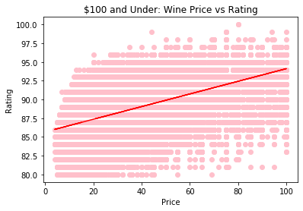
Does Price Impact Rating: $100 and Under
For this portion we analyzed wine priced $100 and under. Based on our analysis above, we determined that as wine price increases, its rating increases as well. There is a positive correlation (0.54809) between price and rating. This r-value is slightly stronger than the previous analysis of between outlier data.

Slide 7
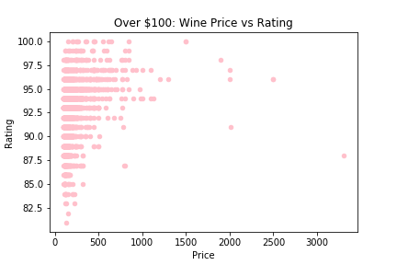
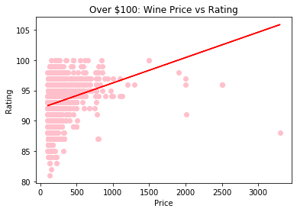
Does Price Impact Rating: Over $100
For this portion we analyzed wine priced over $100. Based on our analysis above, there is a less strong positive correlation between price and rating. The r-value is only 0.24732. However, as wine price increases, its rating increases as well, consistent with wine priced $100 and below.

Slide 8
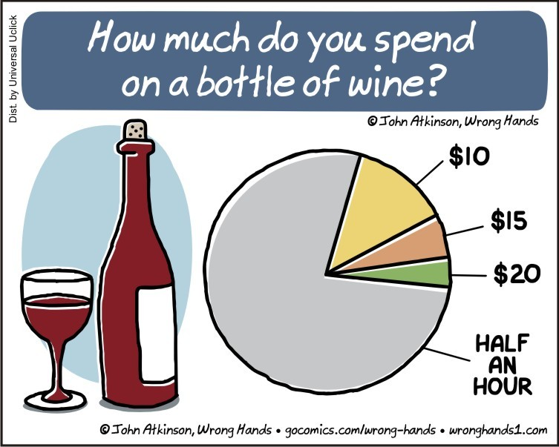

Slide 9
Ratings for top 4 countries
The following graphs describe the relationship of price and rating across the top 4 countries containing the highest amount of data points.
The range of price is inclusive between the lower and upper outlier. Because the upper outliers were so spread, including them skewed the graph making it difficult to measure any relationship between the data.
The relationship of price and rating follows a similar trend for all the countries where as the cost of the wine increases the mean rating increases.
We included scatter plots as well, but there isn’t much information to guage from them due to the sheer number of data point clusters.

Slide 10
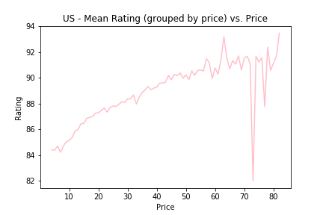
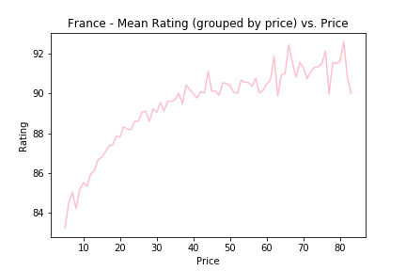
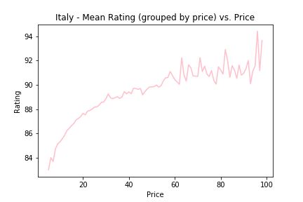
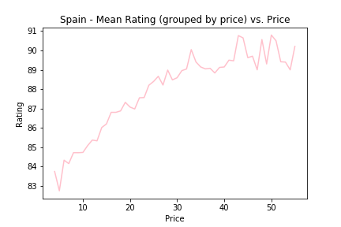
Notes:
In the US graph you can see the sharp dip in rating around the $73 mark. This occurs because there is only one rating for the price point.

Slide 11
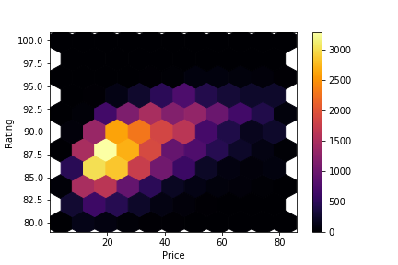
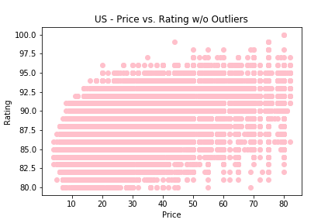
US Rating Distribution
Notes:
You can see that the ratings are much more clustered in the $15-$40 region for most of the countries. Which leads me to believe that a majority of the reviewers are from a lower to mid range income population.

Slide 12
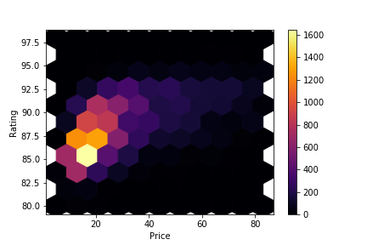
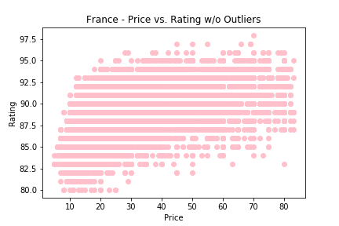
France Rating Distribution

Slide 13
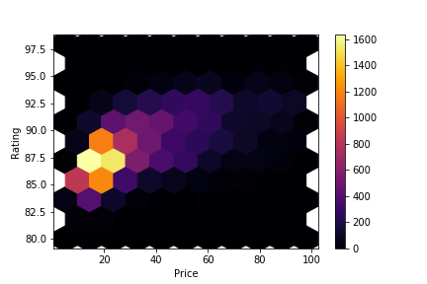
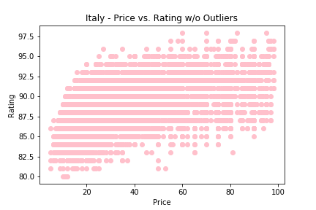
Italy Rating Distribution

Slide 14
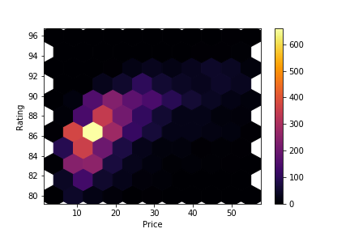
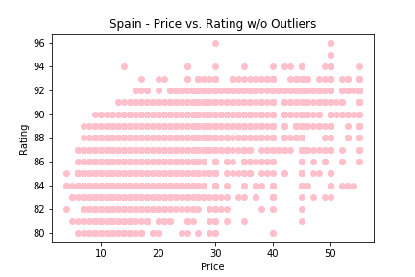
Spain Rating Distribution

Slide 15
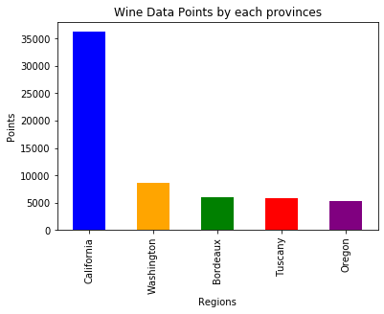
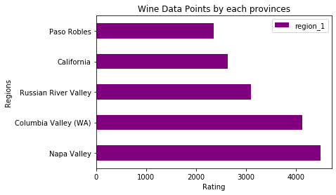
Does Region Impact Ratings?
After doing exploratory data analysis on how regions will impact price with it ratings, The data points distributions varied across each region. For example Napa Valley, will span full range of score but then you have others in the same region have lower points.

Slide 16
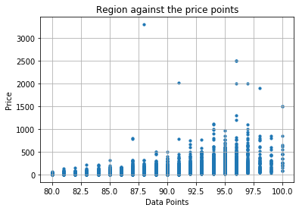
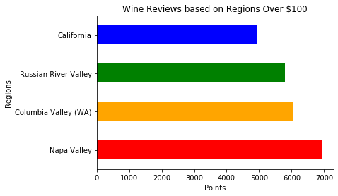
Does Region Impact Price?
Perhaps this could be because some regions may be producing specific type of wine.
When price increases in wine, there rating will be lower
Mean of the region were between 85-94 percent.

Slide 17
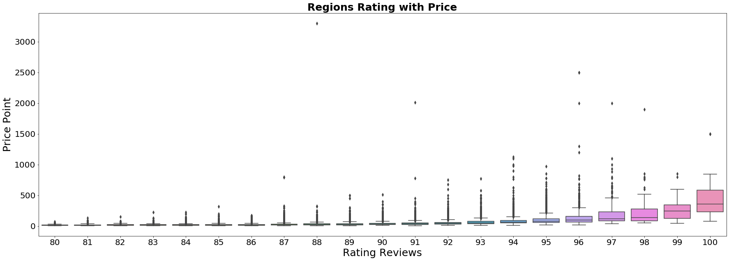
Regions with data points with price
After analyzing the data points with different regions, was able to do group by with different data points against the price of wine, as projected per box plot, we can analyze that data points will decrease as the price increases of wine.
The Box Plot show regions points with price versus it reviews that were received by each regions.

Slide 18
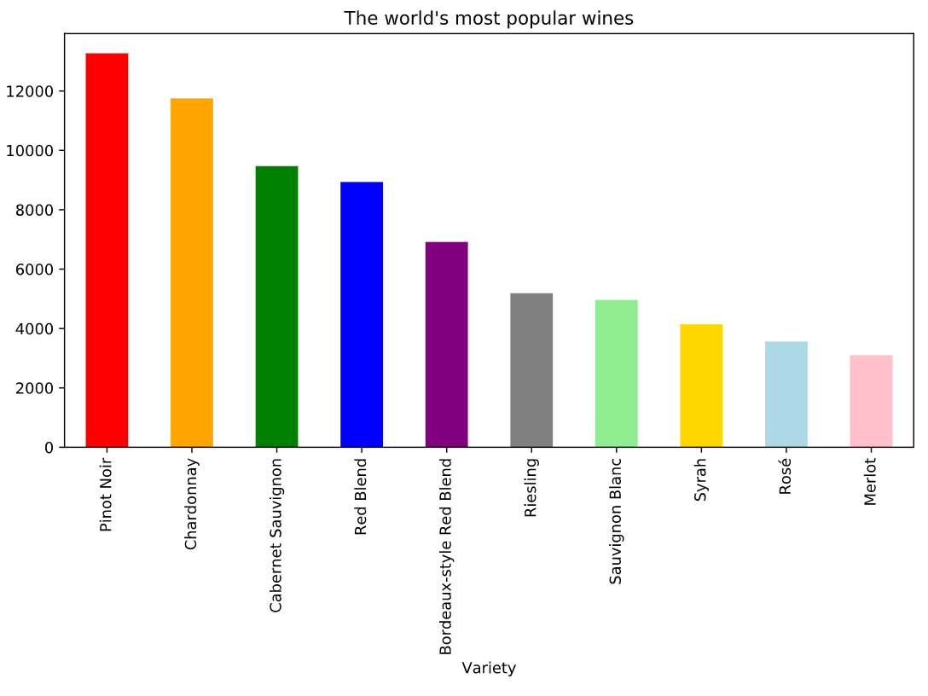
What is the Most Popular Variety?
Using groupby data of variety and country, here are the world’s top 10 most popular wines.

Slide 19
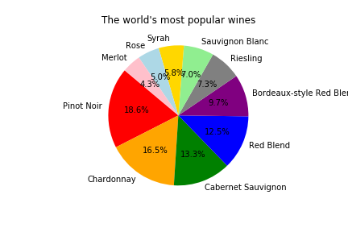
What is the Most Popular Variety?
And here is the data in everyone’s favorite visual - the pie chart.

Slide 20
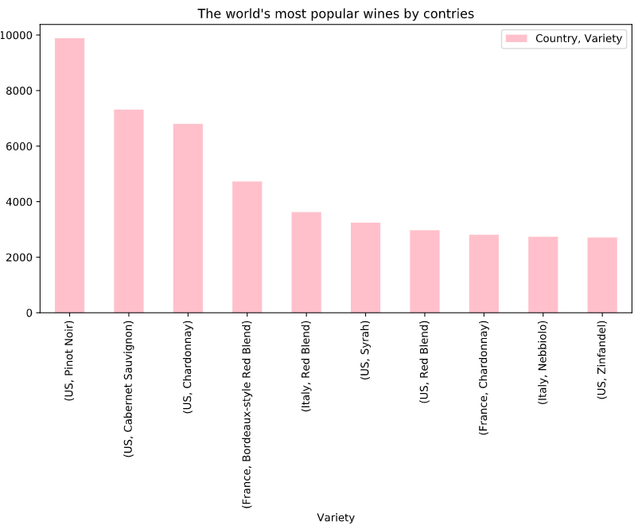
What is the Most Popular Variety?

Slide 21
Discussion
Data: The magazine that the data was scrubbed from only kept ratings over 80 which we did not find out till quite a bit later. Next time we’ll have to read the description of the data more thoroughly that way we can find a data set with a less bias data pool.
Wine Price vs Rating: As expected, as wine price increases, rating typically increases. For wines $100 and under, there was a medium positive correlation between price and rating. For wines over $100, there was a low positive correlation between price and rating. Unfortunately, whoever bought a $3,300 bottle of wine rated it under 90%.
Region vs Price: Data points varied across each regions. For example, there were winery in same region which had full range of scores compare to others in the same regions. This could be because they may produce specific type of wine. Regions which had the highest data points also had lower review ratings per consumers.
Variety: Pinot noir is the most popular variety. Based on the data, people like red wines more than white wines (except chardonnay and riesling).

Slide 22
Post Mortem
Difficulties experienced:
Finding 2019-2020 wine data via sites that allow API
Magnitude of data points made it harder to find clear trends
Attempting to create a bar plot for wine price vs rating
Additional questions we could ask of the data:
Which variety is most expensive?
Which wines received a 100% rating?
Are we able to build a recommendation engine to suggest wines to users based on their wine ratings?
What job do you need to have to buy a $3,300 bottle of wine??!??

Slide 23

Questions?
Disclaimer: We do not have any wine samples for you (thanks Corona).
Another disclaimer: No wine was consumed during the making of this project.

